Slide 1

Real-Time Multi-Mode Decision Support
A machine learning-powered system bridging complex data analysis and actionable decisions — across organizational marketing and personal productivity workflows.
FLASK · SCIKIT-LEARN · RANDOM FOREST

Slide 2

The Problem: Information Overload
Organizational Marketing
Personal Productivity
Individuals face fragmented task signals and unstructured inputs, lacking intelligent tools to triage priorities, surface relevant patterns, and drive daily decision-making with data-backed clarity.
Marketing teams drown in customer behavioral data — purchase histories, channel engagement, and recency signals — with no unified system to convert raw metrics into prioritized campaign actions in real time.

Slide 3
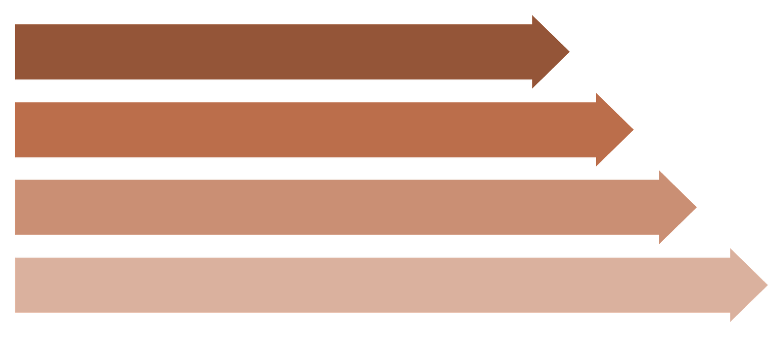
System Architecture: Dual-Mode Framework
User Input
Flask Backend
ML Model
Dashboard
A single Flask backend routes requests across both modes. Preprocessed feature vectors are passed to the trained model, which returns confidence-scored decisions rendered instantly on the dashboard — no page reload required.

Slide 4
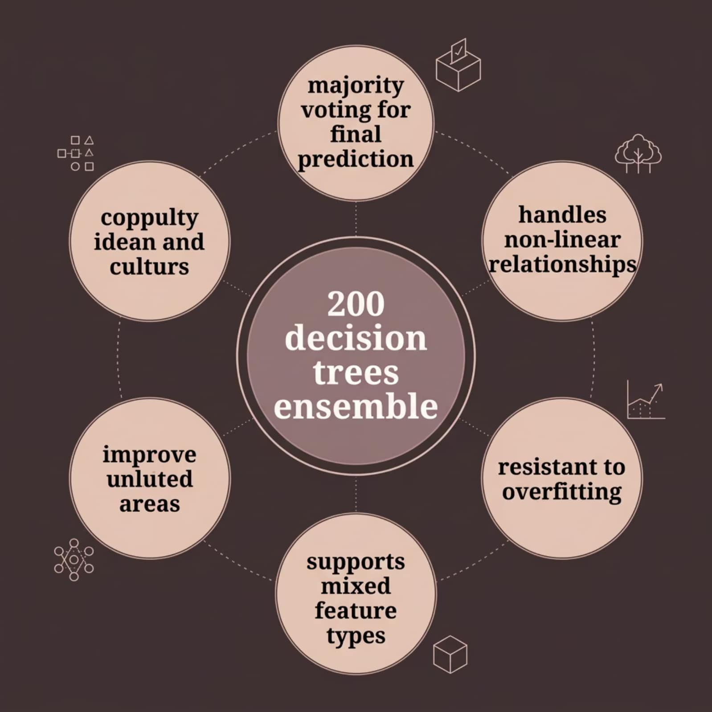

Model & Algorithm Analysis
Feature Engineering
Demographic
Recency
Income level as a primary behavioral segmentation signal
Days since last purchase — critical for churn and engagement scoring
Purchase Channels
NLP Keywords
Web, Catalog, and Store purchase counts as multi-channel behavior vectors
Keyword-based feature engineering for unstructured personal productivity inputs

Slide 5
Performance Metrics
87%
200
~12ms
Accuracy
Estimators
Inference Speed
Validated on held-out test set across both operational modes
Decision trees in the Random Forest ensemble for robust consensus
Average response latency from feature input to decision output
Why Random Forest?
Evaluation Protocol
Marketing and productivity data are inherently non-linear — customer behavior doesn't follow simple thresholds. Random Forest's ensemble of decorrelated trees captures complex feature interactions without overfitting, delivering stable predictions even with noisy, high-dimensional inputs.
Precision
Recall
Minimizing false positives in campaign targeting recommendations
Maximizing capture of true high-value decision signals

Slide 6


Results & Real-Time Dashboard
Feature Impact Plots
Chart.js renders live feature importance distributions directly in the browser — no backend round-trip needed for visualization refresh.
Matplotlib Exports
Server-side Matplotlib generates static decision boundary and confusion matrix plots, embedded as base64 assets for reporting and audit trails.
Instant Feedback Loop
Predictions surface within milliseconds of form submission, enabling iterative "what-if" scenario exploration across both organisational and personal modes.

Slide 7

Outcome & Conclusion
Bridging the Gap
The system transforms raw behavioral and productivity data into prioritized, confidence-scored recommendations — eliminating manual analysis latency and empowering both marketers and individuals to act decisively.
Complex ML inference abstracted behind a clean Flask API
Dual-mode flexibility scales from enterprise teams to solo users
Real-time visualizations make model reasoning transparent and auditable

Slide 8

Technical Documentation & Source Code
Project Repository
1
2
Full source code, model training notebooks, Flask application, and deployment instructions are maintained in a public GitHub repository. Contributions, issues, and forks are welcome.
/model
/app
Trained Random Forest artifacts, feature encoders, and serialized pipeline
Flask routes, REST API endpoints, and Jinja2 template layer
GitHub Repository: https://github.com/Mohammed-Waseemaddin-1216/Decision-Support-System
3
4
/notebooks
/docs
EDA, model training, hyperparameter tuning, and evaluation reports
Architecture diagrams, API reference, and deployment runbook
Stack
License
Python · Flask · Scikit-Learn · Pandas · Chart.js · Matplotlib
Mohammed Waseemaddin— open for academic and commercial adaptation

Slide 9
Thank You!
I appreciate your time and attention. For more information or collaboration inquiries about the Real-Time Multi-Mode Decision Support system, please reach out.
Presenter
Contact
Mohammed Waseemaddin
waseemaddin.wm@gmail.com

